Slide 1
Mount Auburn Professional Services
Practice Improvement Project
Mount Auburn Medical Associates
Appointment Referral Management
“Closing The Loop”
Colon Cancer Screening
9/25/2015

Slide 2
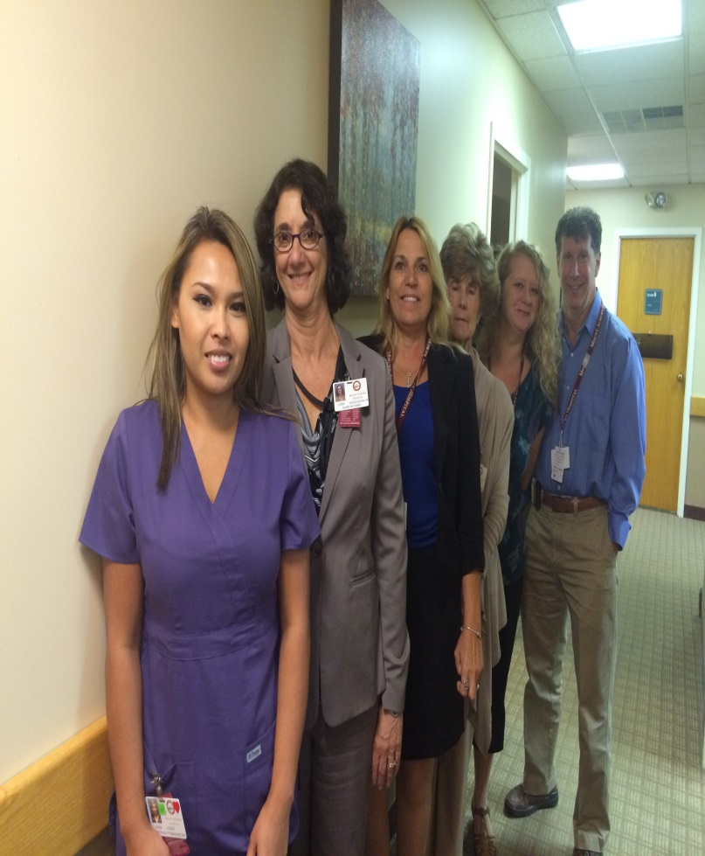
Practice Improvement Team
Anna Lourn, Medical Assistant
Lora-Gross-Kostka,RN,BSN Manager, Ambulatory Risk/Patient Safety Advisor
Sandra De Francisco, Practice Mgr. Team Leader
Judy McGrath, Medical Secretary
Erika Anderson, Referral Manager
Andrew Cutler, MD, Physician Champion

Slide 3
Aim Statement
Dr. Andrew Cutler of Mt. Auburn Medical Associates seeks to discuss and document Colon Cancer Screening with 100% of his empaneled patients who fit the following criteria by June 1, 2016.
  Patients age 50 thru 80 who have not had a colon cancer screening with recommended studies within requisite time frame.
  100% of those who agree to be screened will either be secured an appointment with the Gastrointestinal Specialist for consideration of a colonoscopy or be provided testing materials for the FIT test.
  A follow up conversation with every patient

Slide 4
Referral Management Work Flow
Colon Cancer Screening Referral Order Created
GI Consult Note or FIT Test Results Electronically returned to PCP (P2P, Fax, Lab Encounter, etc)
Patient Follow up with PCP and Next Steps Discussed
Appointment Scheduled With GI or FIT Test and Instructions Given
Patient Seen By GI or FIT Test Returned and processed
Future Appointment Alerts are Created for Future Follow
Insurance Authorization Referral Processed
Consult Note Electronically Sent to Specialist (P2P, fax, etc)

Slide 5
Dr. Cutler’s Panel: Who meets the criteria for Colon Cancer Screen Risk Assessment?
Registry Report was run on June 9, 2015
Included all patients age 50 thru 80
Assigned to Dr. Cutler as the Primary Care Provider
Have been seen in the past 10 years
1038 patients are listed with Dr. Cutler as the PCP.
310 patients have not had the Colon Cancer Screening documented in the Medical Record

Slide 6
Dr. Cutler’s Registry Breakdown
# of Patients | Status
107 | Documentation in EMR – discussed and declined
80 | Not been seen since 2007
85 | Seen before age 50
17 | Secured or were pending an appointment or were missed and were pending to be rescheduled.
14 | Had prior screening (Flexible Sigmoidoscopy, FIT Test, or Fecal Occult Cards)
7 | Terminally ill
Notes:
Registry Report: Included all patients between the ages of 50 thru 80, assigned to Dr. Cutler, who have been seen in the past 10 years
107 patients had documentation in EMR (Discussed or Declined)
80 patients have not been seen since 2007
85 patients have been seen before they were age appropriate
17 patients had secured or were pending an appointmnet or were missed and were pending to be rescheduled.
14 patients had prior screening (Flex Sigmoidoscopy, FIT test, Giauiac Stool Cards)
7 Medically indicated (terminal)

Slide 7
Surprises
  P2P Application
  GI Scheduling
  Colonoscopy Prep
  Future Recommended Follow Up Appointment with GI

Slide 8
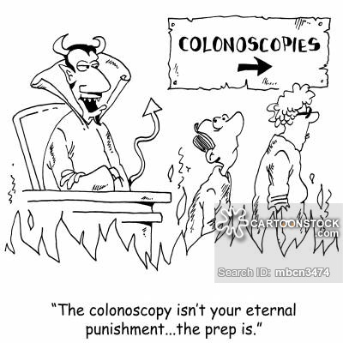
What are the Barriers?

Slide 9
Patient Safety & Efficiency
Patient Safety | Efficiency
Faxed GI Notes | Standard reliable process forwarding GI notes
Patient refuses colonoscopy or FIT | Standard outreach/documentation process when patients refuse
A follow-up conversation with every patient (and documented) | Standard expectation of communication and by whom
Process (Alerts) for Recommended Follow Up | Standard communication process to schedule future appointments

Slide 10
Next Steps
3 Patients will review our Colonoscopy Outreach Letter
3 Patients will provide feedback regarding the Patient Portal

